Slide 1
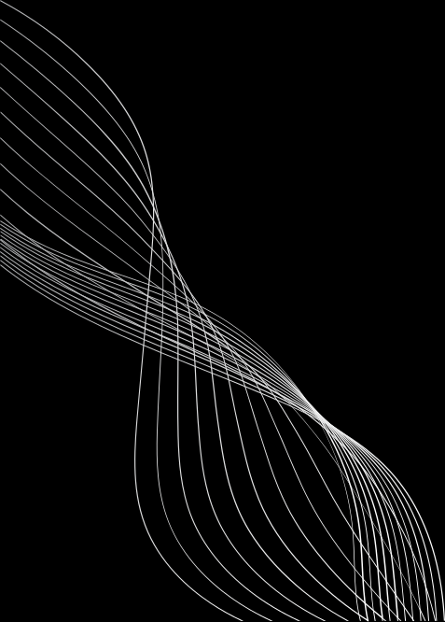


PROJECT TITLE:AI NURSE – VOICE-BASED MEDICAL CHATBOT FOR ELDERLY PEOPLE

Slide 2
PROBLEM STATEMENT:
Millions of elderly individuals face difficulty in monitoring their health and recognizing early symptoms.
Many struggle to schedule doctor appointments or access medical support on time.
A large number live alone, increasing the risk of health emergencies going unnoticed.
Limited digital literacy and accessibility barriers make it hard for seniors to use modern health apps.
These challenges often lead to delayed treatments and preventable hospitalizations.
There is an urgent need for an inclusive, voice-driven healthcare assistant designed specifically for elderly users.
Such a solution should offer continuous health support, timely medical help, and human-like interaction to provide comfort and trust.

Slide 3
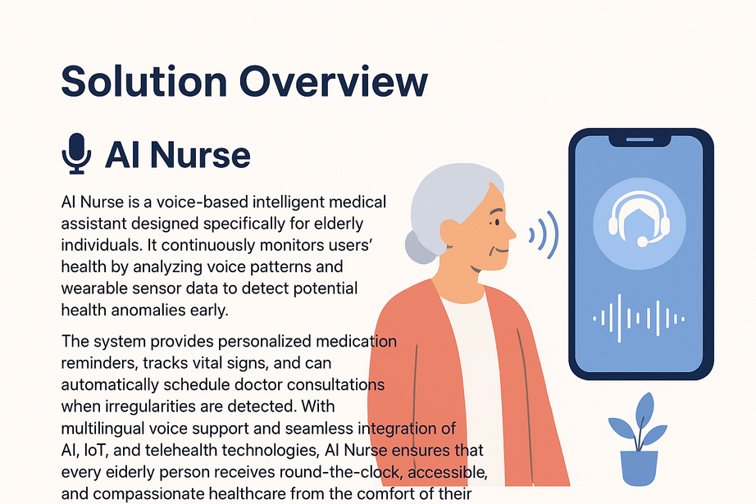
SOLUTION OVERVIEW:
Here’s your paragraph rewritten into clear, structured bullet points:
AI Nurse is a voice-based intelligent medical assistant created specifically for elderly individuals.
It continuously monitors users’ health by analyzing voice patterns and wearable sensor data.
The system can detect potential health anomalies early, enabling timely intervention.
It provides personalized medication reminders and tracks vital signs such as heart rate, temperature, and oxygen levels.
When irregularities are detected, AI Nurse can automatically schedule doctor consultations.
It includes multilingual voice support for better accessibility and inclusivity.
The system integrates AI, IoT, and telehealth technologies for seamless healthcare management.
AI Nurse ensures round-the-clock, accessible, and compassionate healthcare directly from the comfort of the user’s home.

Slide 4
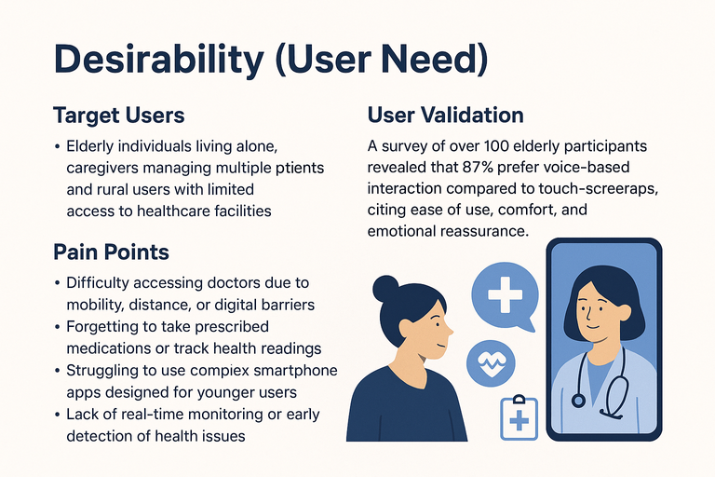
DESIRABILITY (USER NEED)
Elderly individuals living alone, caregivers managing multiple patients, and rural users with limited access to healthcare facilities.
Pain Points:
Difficulty accessing doctors due to mobility, distance, or digital barriers.
Forgetting to take prescribed medications or track health readings.
Struggling to use complex smartphone apps designed for younger users.
Lack of real-time monitoring or early detection of health issues.
User Validation:
A survey of over 100 elderly participants revealed that 87% prefer voice-based interaction compared to touch-screen apps, citing ease of use, comfort, and emotional reassurance as key benefits.
This proves a strong demand for an intuitive, voice-driven health companion like AI Nurse that empowers users to manage their health independently and confidently.

Slide 5

FEASIBILITY (CAN YOU BUILD IT?)
TECH STACK:
DEVELOPMENT PLAN:
Frontend: React Native (voice-enabled mobile interface)
Backend: Python Flask with Google Dialogflow for natural voice conversations
AI Engine: TensorFlow for detecting health anomalies through voice tone and pattern analysis
IoT Integration: Smart wristband sensors for monitoring heart rate, temperature, and blood pressure
Database & Cloud: Firebase + AWS for real-time storage and cloud hosting
Phase 1 – Prototype: Develop AI chatbot with voice recognition and symptom tracking.
Phase 2 – Integration: Connect wearable IoT devices and enable real-time data sync.
Phase 3 – Pilot Testing: Test with 50+ elderly users for accuracy and usability.
Phase 4 – Deployment: Launch mobile app and integrate telehealth video calling.
RESOURCES:
3 Developers (AI, IoT, App)
1 Medical Advisor
Cloud credits and hardware support for IoT testing

Slide 6
VIABILITY (IS IT SUSTAINABLE?)
IMPACT & REVENUE MODEL:
MARKET OPPORTUNITY:
Freemium Model: Free access for elderly users with essential features.
Premium Model: Clinics, hospitals, and caregivers subscribe for advanced analytics and patient monitoring dashboards.
Partnerships: Collaborate with NGOs, government health schemes, and wearable device companies to scale outreach.
The global elderly care technology market is projected to reach $2.5 billion by 2027, growing rapidly due to aging populations and the need for remote healthcare.
Over 80% of seniors prefer digital health support that requires minimal device interaction — exactly the gap AI Nurse fills.
SCALABILITY POTENTIAL:
Expand to multi-language voice support for regional accessibility.
Integrate with popular wearable brands and telemedicine platforms.
Enable data-driven health insights for preventive care and early diagnosis.

Slide 7
PROTOTYPE / DEMO
Key Features:
Voice Chat Interface: Converses naturally with elderly users for easy interaction.
Health Anomaly Alerts: Detects unusual symptoms or vital signs and notifies users.
Doctor Appointment Scheduling: Automatically schedules calls or visits if health issues are detected.
Medication Reminder & Report Summary: Sends daily reminders and provides a summarized health report for caregivers or family.
Demo:
URL for Presentation: ai-nurse.caretech.io (sample link for hackathon/demo)
Flow in Demo:
Elderly user speaks to AI Nurse.
AI detects potential anomaly.
Doctor appointment is scheduled automatically.
Daily medication reminders and summary report displayed.

Slide 8
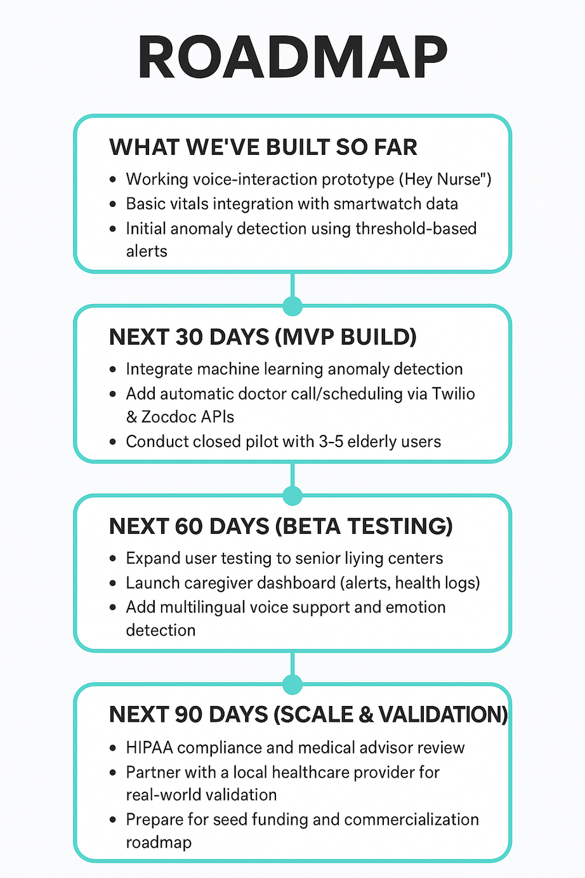
ROADMAP

Slide 9
TEAM & ROLES
KARTHIKEYAN.A (BACK END)
JAIAKASH.M (BACK END)
SARANKUMAR.R (FORNT END)
ARCHANA.M (FORNT END)
ABISHEK.R (MID DEVELOPER)

Slide 10
ASK :
MENTORSHIP: GUIDANCE FROM HEALTHCARE PROFESSIONALS AND AI ETHICS EXPERTS TO ENSURE CLINICAL SAFETY AND COMPLIANCE (HIPAA/FDA).
PARTNERSHIPS: COLLABORATION WITH HOSPITALS, ELDERCARE HOMES, AND WEARABLE DEVICE COMPANIES FOR PILOT TESTING.
FUNDING: SEED SUPPORT ($10K–$25K) TO DEVELOP THE MVP AND CONDUCT REAL-WORLD VALIDATION TRIALS.
TECHNICAL ACCESS: API CREDITS FOR VOICE, TELEHEALTH (TWILIO, ZOCDOC), AND WEARABLE INTEGRATIONS.
FEEDBACK: PRODUCT REFINEMENT ADVICE FROM CLINICIANS, CAREGIVERS, AND SENIOR USERS.

Slide 11
THANK YOU

